Slide 1
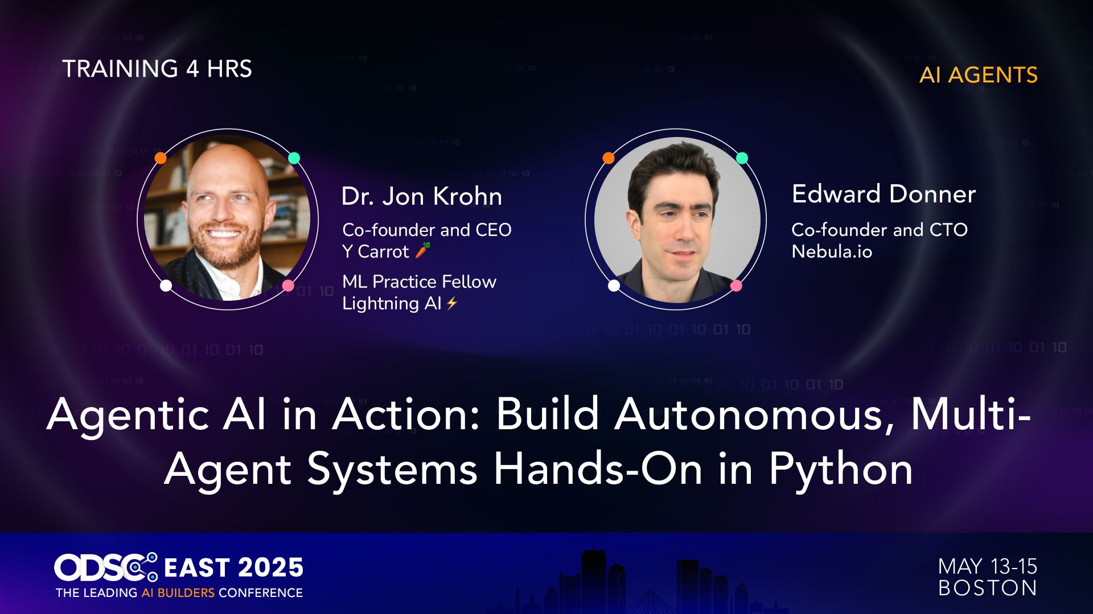

Slide 2


Slide 3
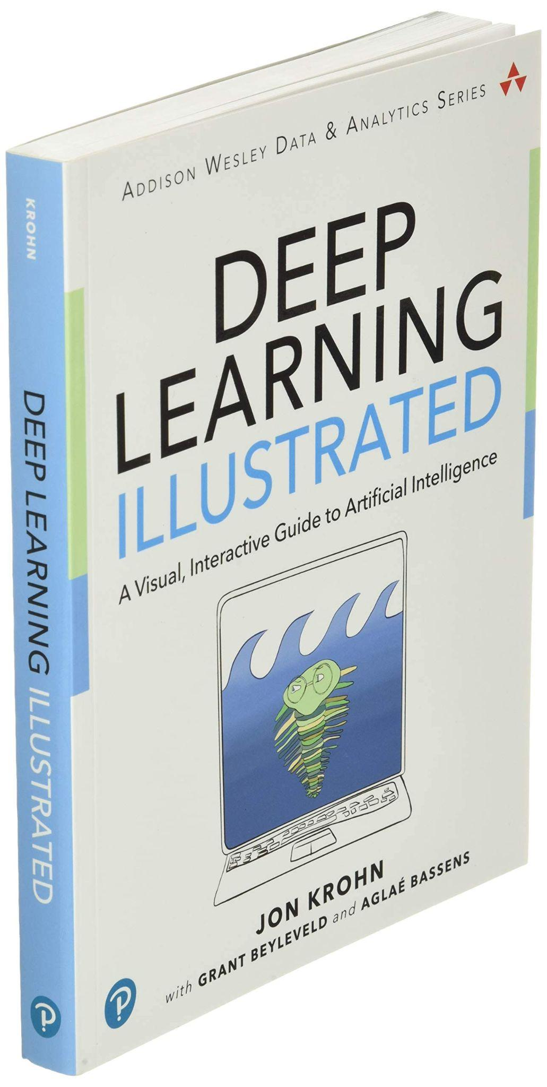




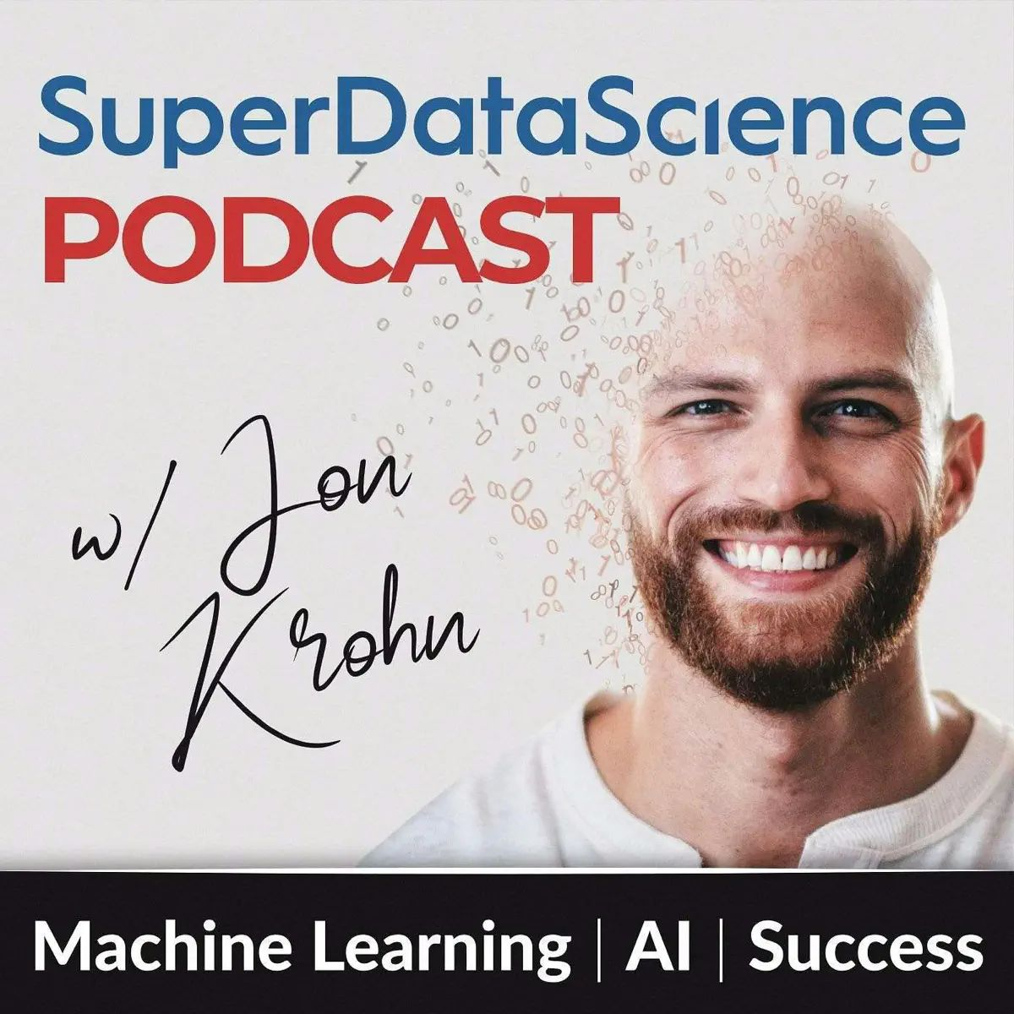





Notes:
N.B.: YouTube and Udemy deleted for ODSC (Ai+) purposes only

Slide 4






Module 1:
Defining Agents
Module 2:
Designing Agents
Module 3:
Developing Agents
Module 1 Coding:
Deep Research
with OpenAI Agents SDK
Module 2 Coding:
Engineering Team
with CrewAI
Module 3 Coding:
Autonomous Traders
with MCP

Slide 5
Module 1:
Defining Agents
Module 1 Coding:
Deep Research
with OpenAI Agents SDK

Slide 6

Defining Agents (it’s ambiguous…)
"AI Agents are programs where LLM outputs control the workflow."
In practice, describes an AI solution that involves any or all of these:
1. Multiple LLM calls
2. LLMs with ability to use Tools
3. An environment where LLMs interact
4. A Planner to coordinate activities
5. Autonomy

Slide 7
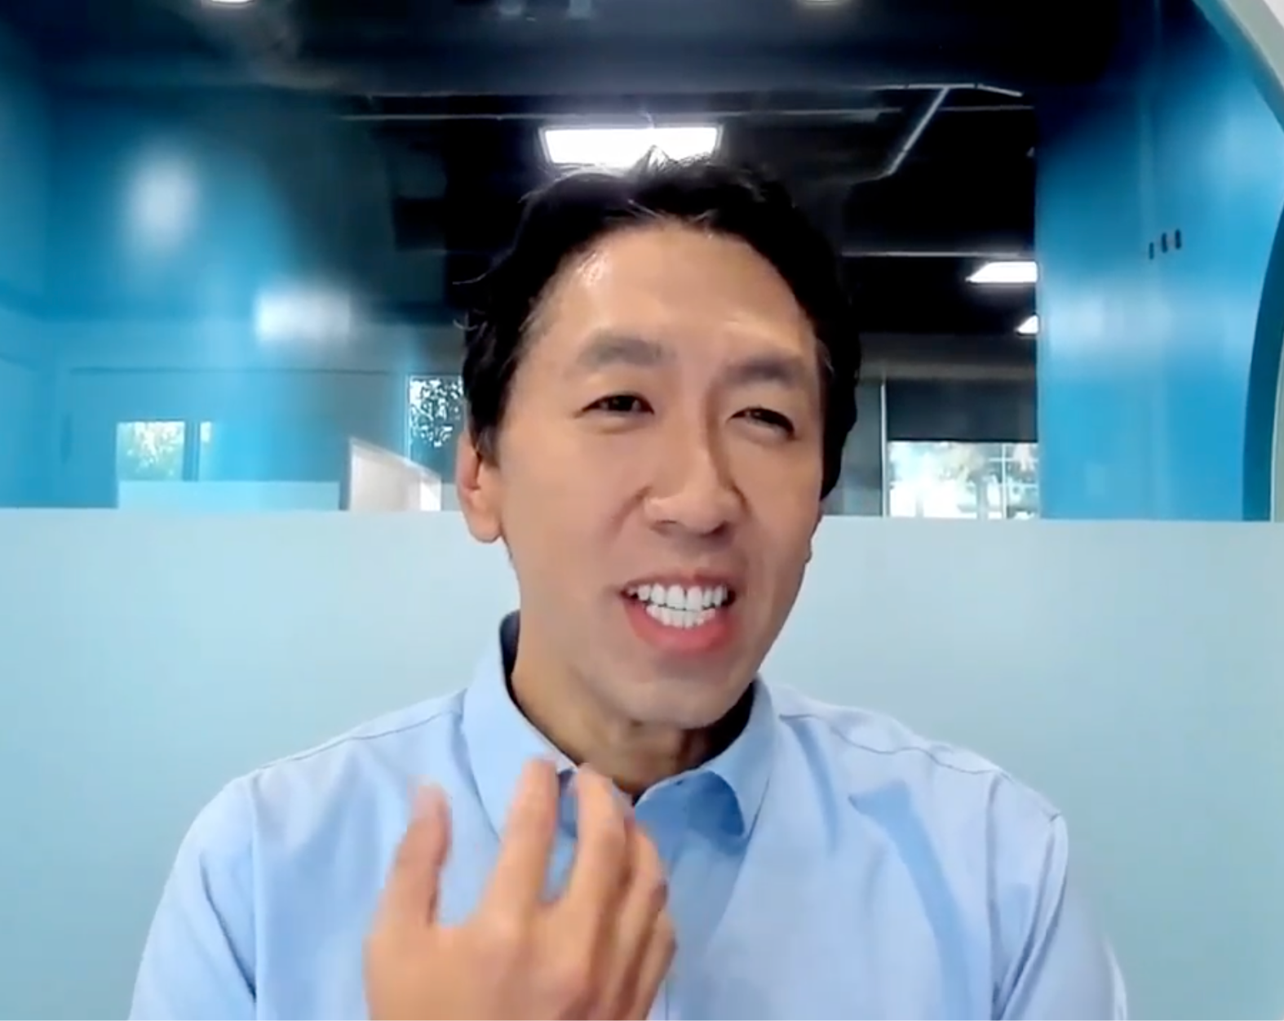
Episode #841
Andrew Ng

Slide 8

Episode #867
Andriy Burkov

Slide 9
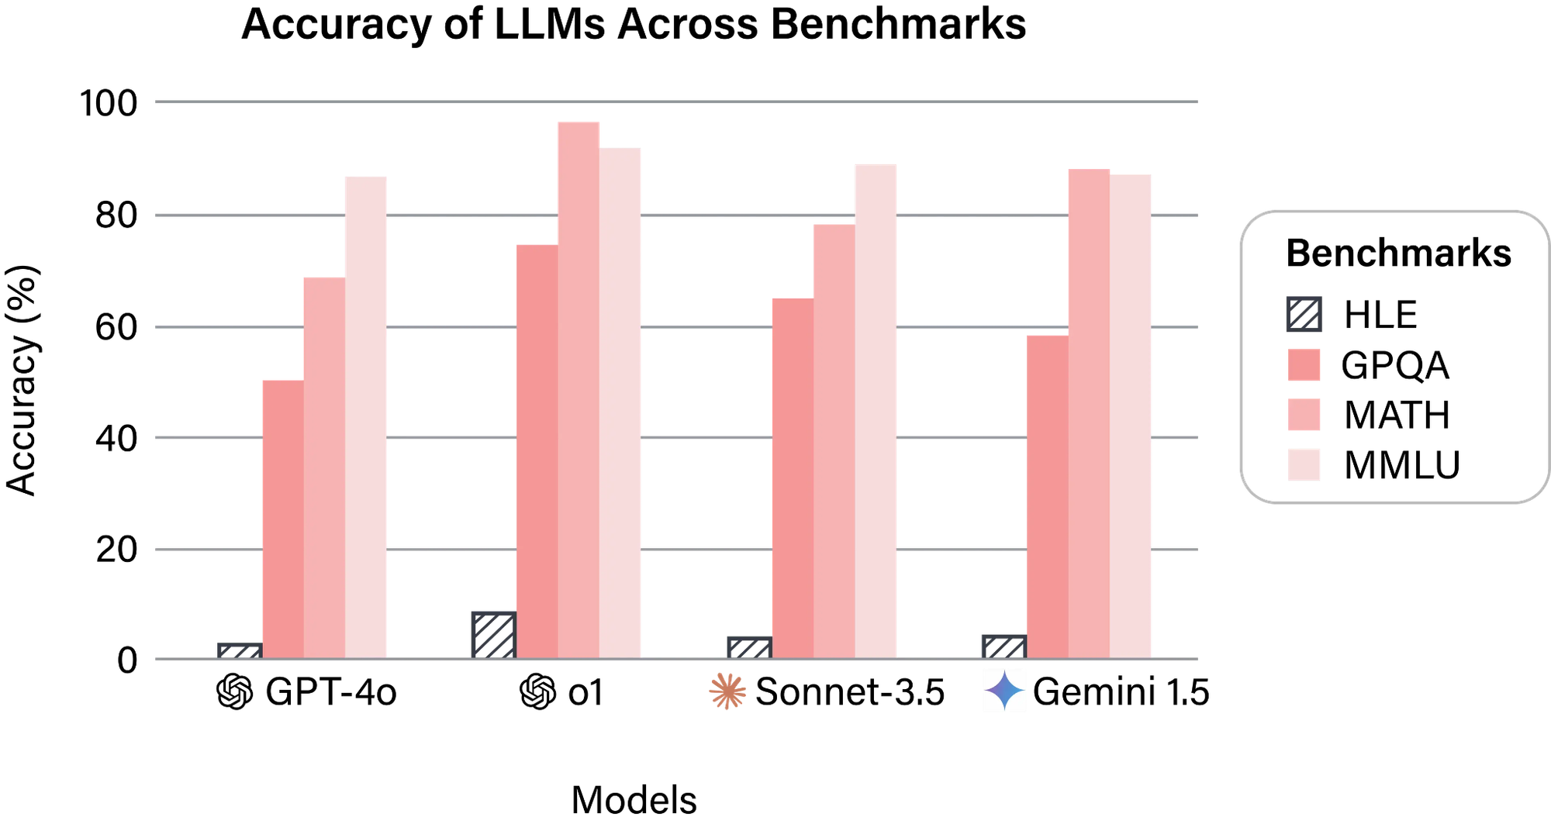
Source: agi.safe.ai

Slide 10
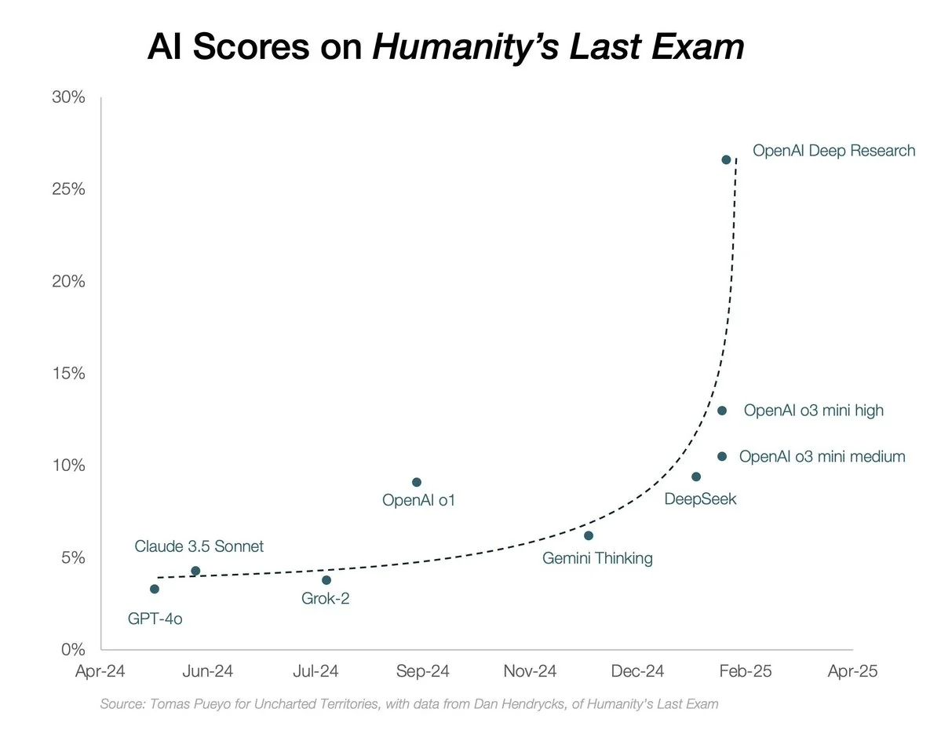

Slide 11
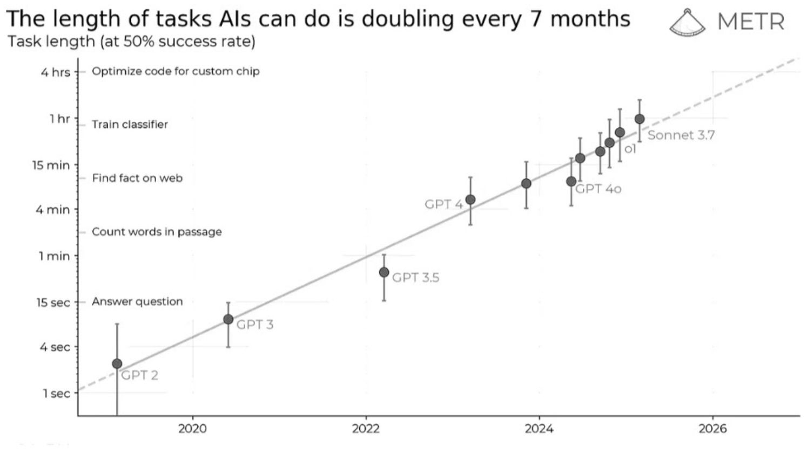

Slide 12
It’s
Never
Been
A
Better
Time
To
Develop
AI
Agents
ML/LLM Advancements
Cloud Infrastructure
Data
Open-Source Software
Low-Cost Hardware
Development Tools
Connectivity
Regulatory Environment
Market Demand
Educational Resources

Slide 13
Agents in Action
Code Generation → Team of Software Developers
Medical Diagnosis
Scientific Literature Review
Design and Run Experiments then Write Paper
Replace More and More Enterprise Tasks → First Billion-$ Firm with No Employees?
Notes:
New slide of real-world examples

Slide 14


Agentic Systems
Anthropic distinguishes two types:
Workflows:
Systems where LLMs and tools are orchestrated through predefined code paths
Agents:
Systems where LLMs dynamically direct their own processes and tool usage, maintaining control over how they accomplish tasks

Slide 15
"Tools" give LLMs autonomy
Give an LLM the power to carry out actions like query a database or message other LLMs
Sounds spooky, right?
OpenAI can reach into my computer?!
The reality is a bit mundane

Slide 16



Tool Calling — popular perception
“An LLM can reach into my computer”
Prompt
Response
Code
LLM
EXECUTE

Slide 17
Tool Calling — mundane reality
An LLM responds with the actions needed
Prompt
Response
Code
LLM
EXECUTE

Slide 18
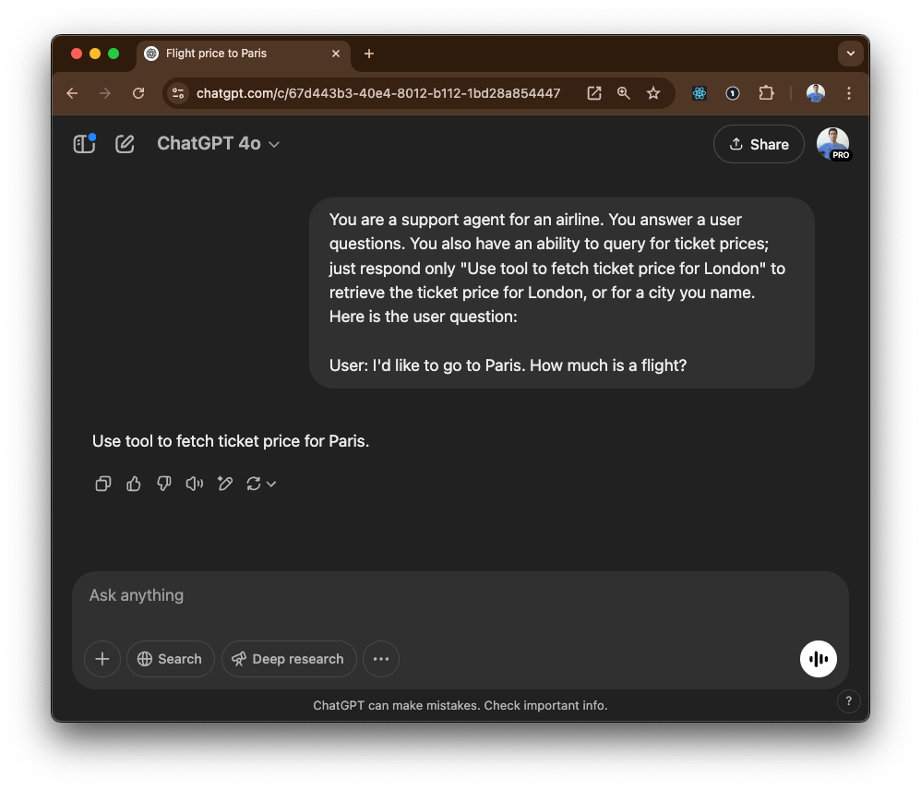
Behold Tool use.

Slide 19





Risks of Agent Systems
Unpredictable path
Unpredictable output
Unpredictable costs
Monitor
"Guardrails ensure your agents behave safely, consistently, and within your intended boundaries"

Slide 20
Agentic AI Frameworks
LangGraph
AutoGen
OpenAI Agents SDK
CrewAI
No framework
MCP
…and many, many more! Which to pick depends on the use case and your preference
Notes:
Jon ends

Slide 21
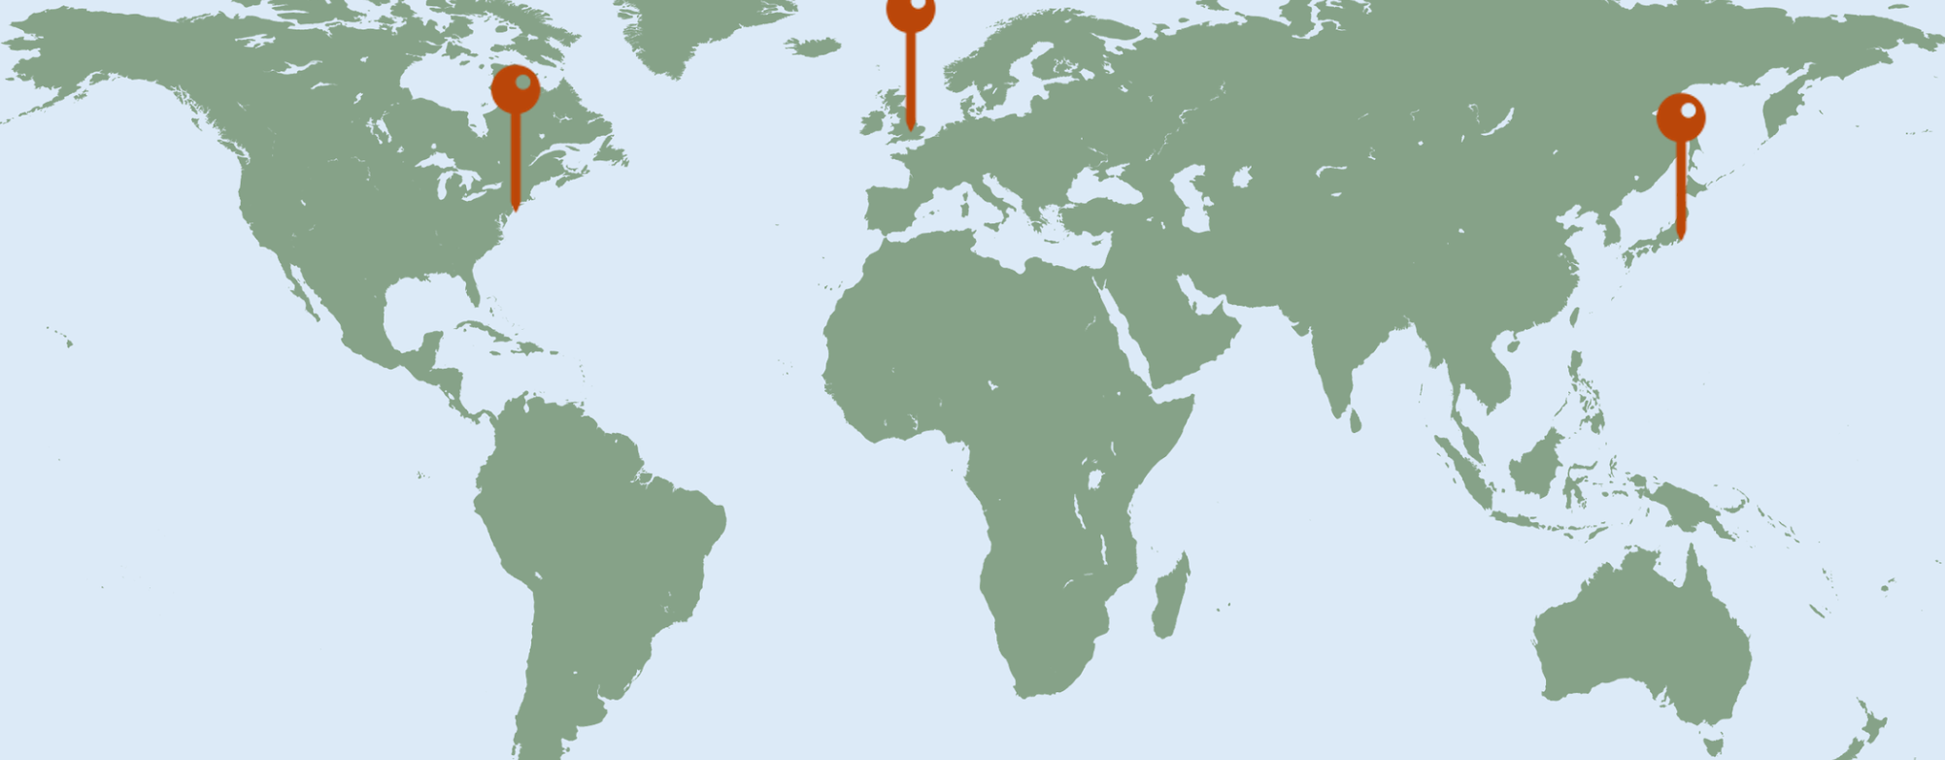

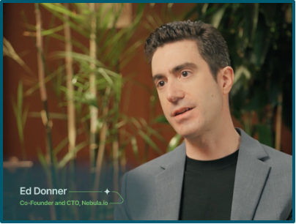
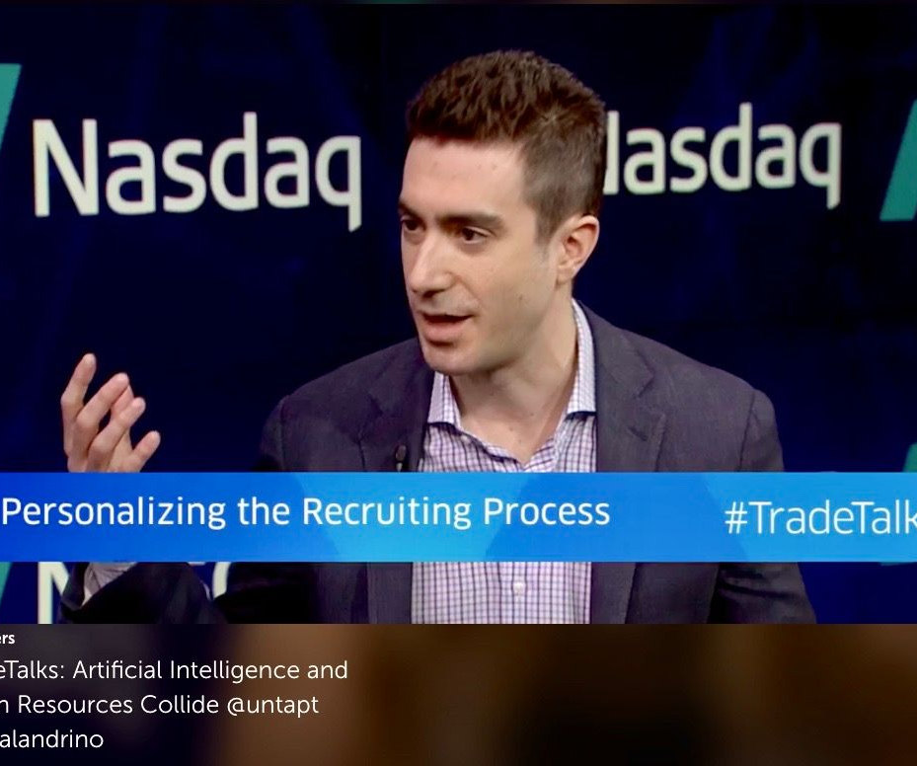
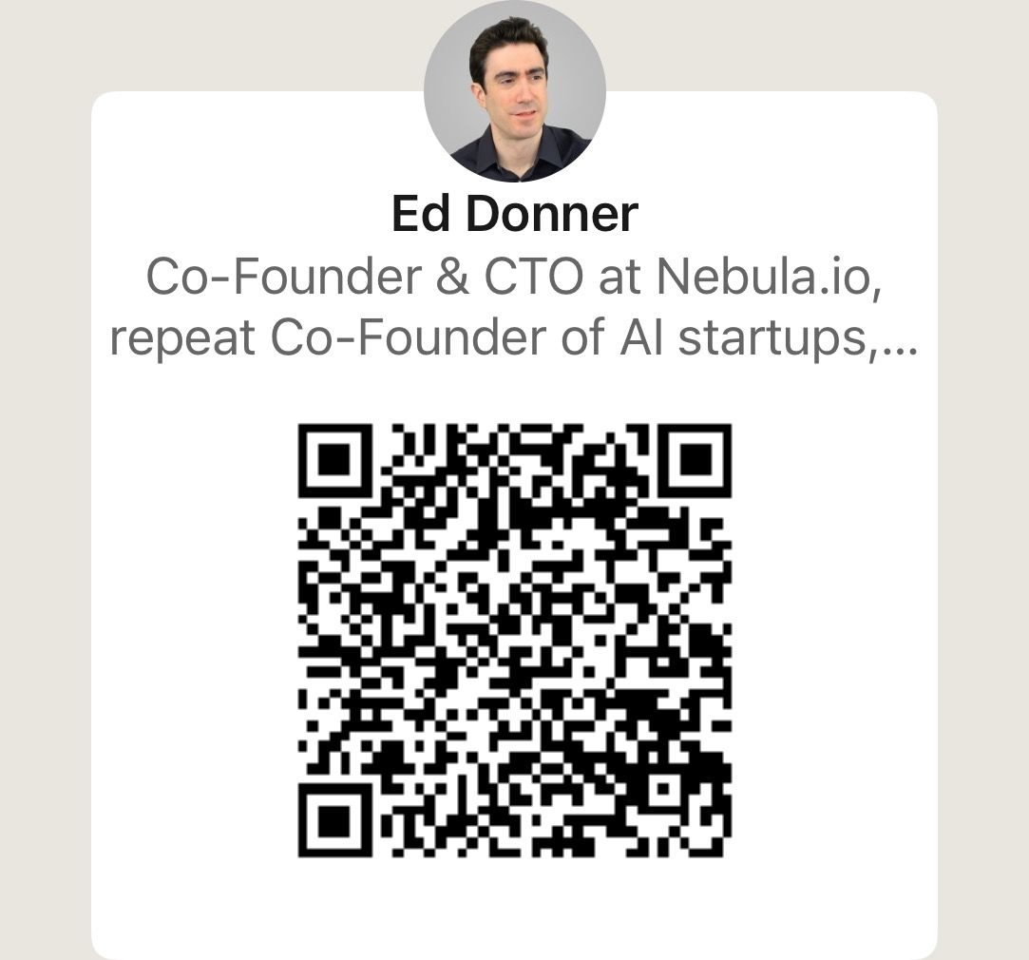
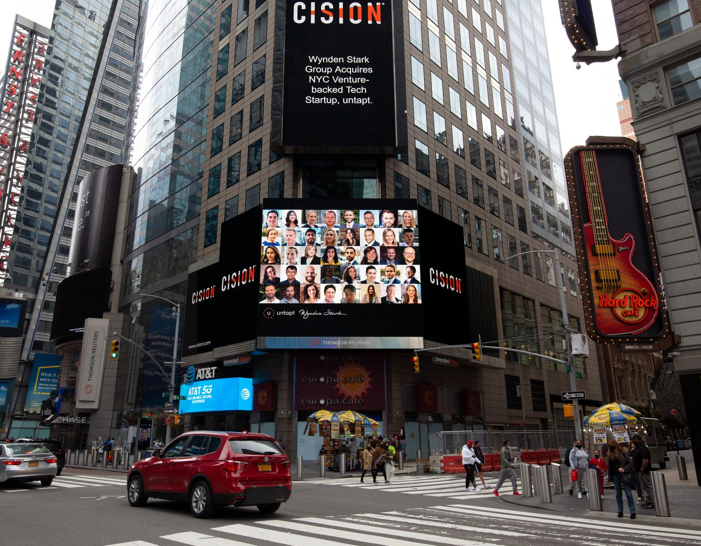

https://www.linkedin.com/in/eddonner/
That’s me!!
..and that’s Jon!!

Slide 22




Introducing OpenAI Agents SDK
Lightweight and flexible
Stays out of the way
Makes common activities easy
(My favorite)

Slide 23


Minimal terminology
Agents represent LLMs
Handoffs represent interactions
Guardrails represent controls

Slide 24

Three steps
1. Create an instance of Agent
2. Use with trace() to track
3. Call Runner.run() to run

Slide 25


Coding project #1
Deep Research
Good News:
We have quite the treat in store for you
Bad News:
Partly pre-baked! And we will move fast.
Good News:
You can recreate this yourself!
https://github.com/ed-donner/action

Slide 26
Module 1:
Defining Agents
Module 2:
Designing Agents
Module 3:
Developing Agents
Module 1 Coding:
Deep Research
with OpenAI Agents SDK
Module 2 Coding:
Engineering Team
with CrewAI
Module 3 Coding:
Autonomous Traders
with MCP

Slide 27
Module 2:
Designing Agents
Module 2 Coding:
Engineering Team
with CrewAI
Notes:
Jon begins

Slide 28
Agentic Systems
Anthropic distinguishes two types:
Workflows:
Systems where LLMs and tools are orchestrated through predefined code paths
Agents:
Systems where LLMs dynamically direct their own processes and tool usage, maintaining control over how they accomplish tasks

Slide 29

5 workflow design patterns
1. PROMPT CHAINING
Decompose into fixed sub-tasks
LLM2
LLM3
OUT
IN
LLM1
Gate

Slide 30
5 workflow design patterns
2. ROUTING
Direct an input into a specialized sub-task, ensuring separation of concerns
LLM1
IN
LLM Router
LLM2
OUT
LLM3

Slide 31
5 workflow design patterns
3. PARALLELIZATION
Breaking down tasks and running multiple subtasks concurrently
LLM1
IN
Coordi-
nator
LLM2
Aggre-
gator
OUT
LLM3

Slide 32
5 workflow design patterns
4. ORCHESTRATOR-WORKER
Complex tasks are broken down dynamically and combined
LLM1
IN
Orches-
trator
LLM2
Synthe-
sizer
OUT
LLM3

Slide 33
5 workflow design patterns
5. EVALUATOR-OPTIMIZER
LLM output is validated by another
Solution
IN
Gene-
rator
Evalua-
tor
OUT
Accepted
Rejected with feedback

Slide 34

By contrast, Agents:
1. Open-ended
2. Feedback loops
3. No fixed path
Action
HUMAN
LLM Call
ENVIRONMENT
Feedback
STOP
Notes:
Jon ends

Slide 35
CrewAI core concepts
Agent: an autonomous unit, with an LLM, a role, a goal, a backstory, memory, tools
Task: a specific assignment to be carried out, with a description, expected output, agent
Crew: a team of Agents and Tasks; either: Sequential: run tasks in order they are defined Hierarchical: use a Manager LLM to assign
Lightweight, but somewhat more opinionated than OpenAI Agents SDK - more terminology, more prescriptive

Slide 36




Five Steps to a Crew AI project
Create the project with: crewai create crew my_project
Fill in the config yaml files to define the Agents and Tasks
Complete the crew.py module to create the Agents, Tasks and Crew, referencing the config
Update main.py to set any inputs
Run with: crewai run

Slide 37
Giving coding skills to an Agent
It's hard and it's complex, but you can have an Agent in Crew that has the ability to write code, execute it securely isolated in a Docker container, and investigate the results
Except it's not.
Agent( allow_code_execution=True, code_execution_mode="safe" )
These are often described as Coder Agents.

Slide 38





Engineering Team
Engineering Lead
Backend Engineer
Frontend Engineer
Test Engineer

Slide 39
Module 1:
Defining Agents
Module 2:
Designing Agents
Module 3:
Developing Agents
Module 1 Coding:
Deep Research
with OpenAI Agents SDK
Module 2 Coding:
Engineering Team
with CrewAI
Module 3 Coding:
Autonomous Traders
with MCP

Slide 40
Module 3:
Developing Agents
Module 3 Coding:
Autonomous Traders
with MCP
Notes:
Jon (hopefully!) begins

Slide 41

And now!
Introducing the
Model
Context
Protocol

Slide 42
MCP
What it's not
A framework for building agents
A fundamental change to how agents work
A way to code agents
What it is
A protocol - a standard
A simple way to integrate tools, resources, prompts
"A USB-C port for AI applications"

Slide 43
MCP
Reasons not to be excited
It’s just a standard, it’s not tools themselves
LangChain already has a big Tools ecosystem
You can already make any function into a Tool
Reasons to be excited
Makes it frictionless to integrate
It's taking off! Exploding ecosystem
HTML was just a standard, too 😏

Slide 44
MCP Core Concepts
The Three Components:
Host is an LLM app like Claude or our Agent architecture
MCP Client lives inside Host and connects 1:1 to MCP Server
MCP Server provides tools, context and prompts
Example:
Google Maps is an MCP Server with geolocation tools (see here)
You can configure Claude Desktop (the host) to run an MCP Client that then launches the Google Maps MCP Server on your computer

Slide 45
Architecture
Common misconception:
MCP Servers run remotely
Most common reality:
Download open-source MCP Server
Run locally
Your computer
Remote server
Host
MCP Client
MCP Client
MCP Client
MCP Server
Remote server
MCP Server
MCP Server
API

Slide 46
Architecture
Your computer
Remote server
Host
MCP Client
MCP Client
MCP Client
MCP Server
Remote server
MCP Server
MCP Server
API

Slide 47
MCP Servers most often run on your box
Download open-source MCP Servers, run them locally
Your computer
Remote server
Host
MCP Client
MCP Client
MCP Client
MCP Server
Remote server
MCP Server
MCP Server
API

Slide 48
Two "Transport" mechanisms
Stdio spawns a process and communicates via standard input/output
Your computer
Remote server
Host
MCP Client
MCP Client
MCP Client
MCP Server
Stdio
Stdio
Remote server
MCP Server
MCP Server
API

Slide 49
Two "Transport" mechanisms
..while SSE uses HTTPS connections with streaming
Your computer
Remote server
Host
MCP Client
MCP Client
MCP Client
SSE
MCP Server
Stdio
Stdio
Remote server
MCP Server
MCP Server
API

Slide 50
Making an MCP Server
Why make an MCP Server
Sharing! Allow others to incorporate tools and resources
Consistently incorporate all our MCP Servers
Understand the plumbing
Reasons not to make an MCP Server
If it's only for us, then we could just make tools - the @function_tool decorator can make any function into a tool
Notes:
Jon ends

Slide 51





Module 3 Project
Autonomous Traders
Commercial
6 MCP servers with 44 tools and 2 resources
Agent interactions
Autonomous
Do not use for trading decisions!
Note: we will go through the code quickly; use it to get some intuition and explore later!

Slide 52


Slide 53
Module 1:
Defining Agents
Module 2:
Designing Agents
Module 3:
Developing Agents
Module 1 Coding:
Deep Research
with OpenAI Agents SDK
Module 2 Coding:
Engineering Team
with CrewAI
Module 3 Coding:
Autonomous Traders
with MCP

Slide 54
It’s
Never
Been
A
Better
Time
To
Develop
AI
Agents
ML/LLM Advancements
Cloud Infrastructure
Data
Open-Source Software
Low-Cost Hardware
Development Tools
Connectivity
Regulatory Environment
Market Demand
Educational Resources

Slide 55
Workforce Implications
For coming years, more jobs created by AI than lost
However: funding for reskilling programs is key
How data scientists in particular can “future-proof”:
Stay on top of AI trends
Focus on multi-agent orchestration and management
Don’t underestimate power of foundational subjects
Develop domain expertise
Develop human-AI collaboration skills
Hone communication / influence skills within organization
Notes:
New slide of real-world examples

Slide 56

Energy
Nutrition
Lifespans
Education
Freedom from violence
Freedom of expression
Sustainability
Cultural preservation
Exploration
Community

Slide 57





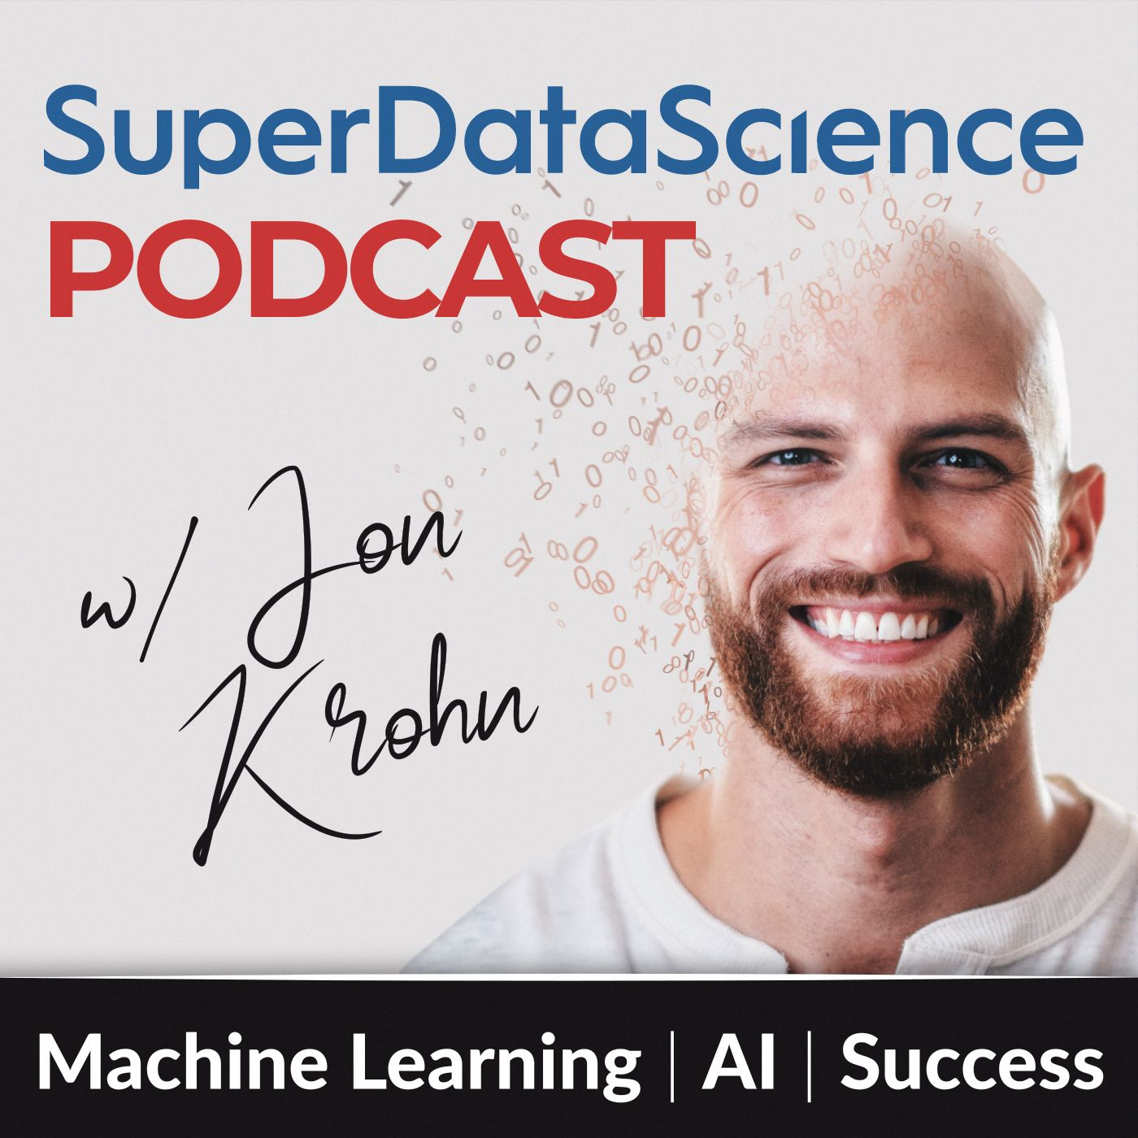


Thank you! Please stay in touch
Jon
Ed
jonkrohn.com to sign up for email newsletter
Full Agentic AI course available on Udemy
linkedin.com/in/jonkrohn
linkedin.com/in/eddonner
youtube.com/c/JonKrohnLearns
edwarddonner.com
ycarrot.com: consulting + hiring!
Complete Agentic AI course on Udemy
• Skip waitlist
• 15 free credits
per month
• 20% off first
month of Pro

Slide 58
Code Screenshots
Outputs to the labs are here:
https://github.com/ed-donner/action/tree/main/outputs

Slide 59
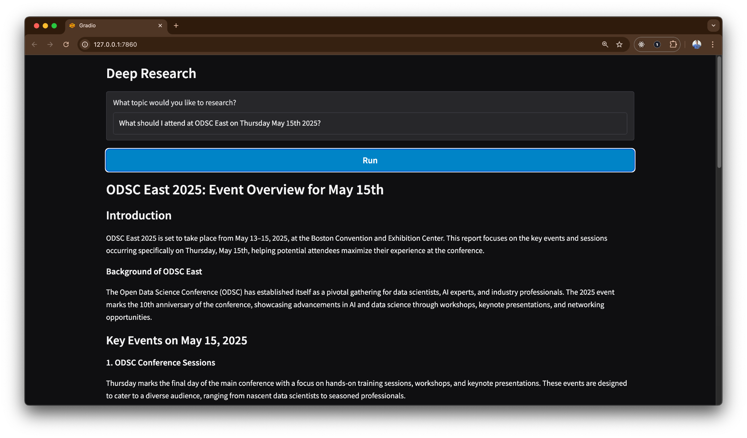

Slide 60
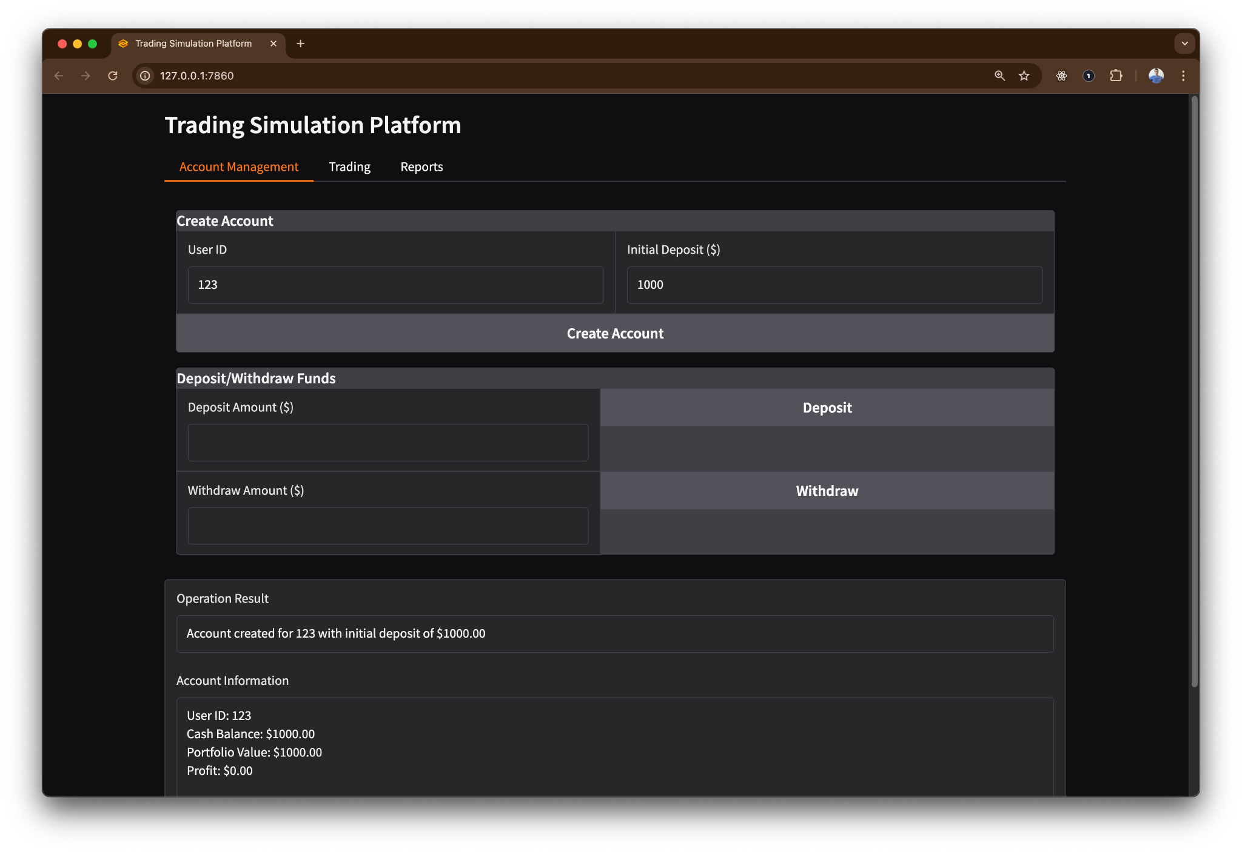

Slide 61
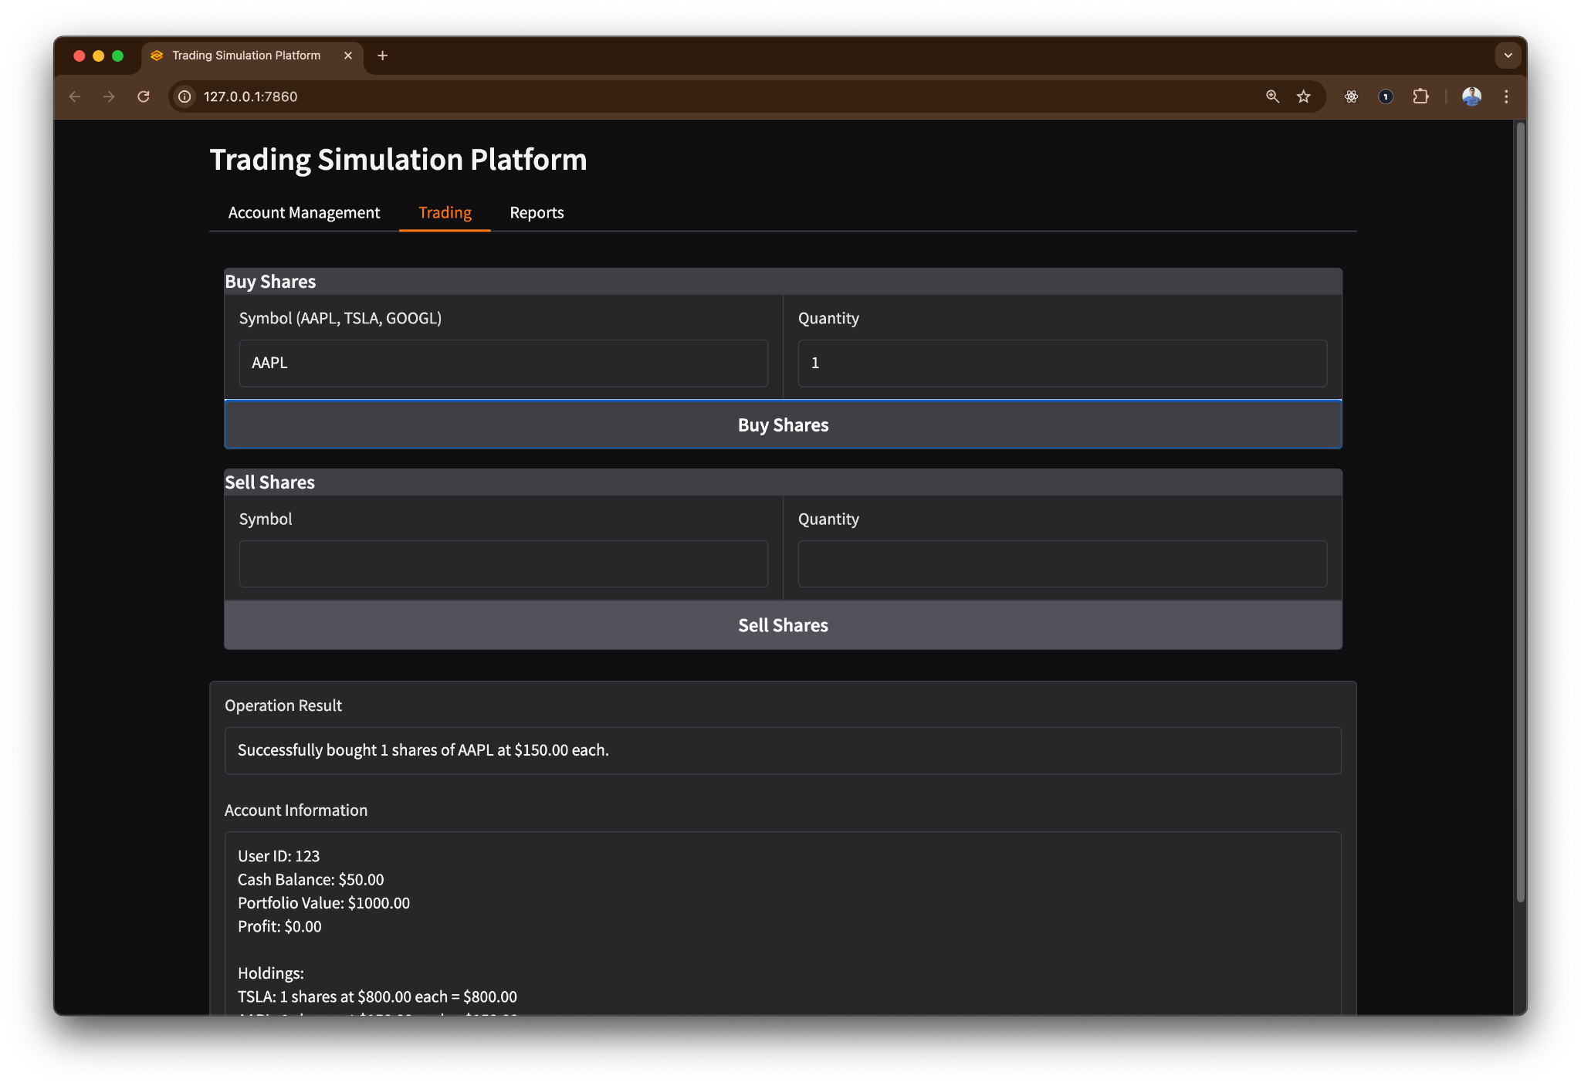

Slide 62
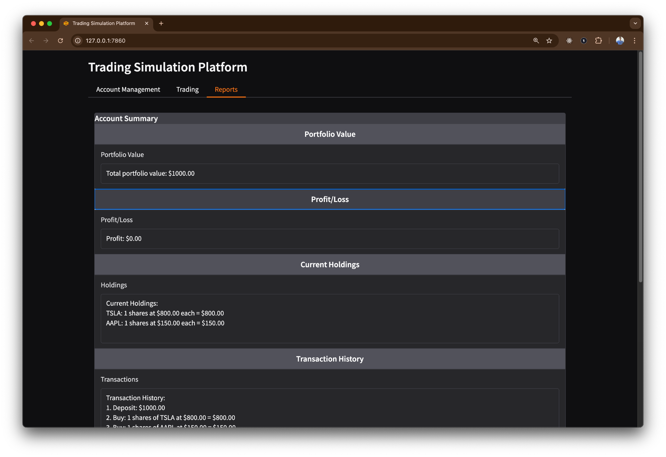

Slide 63
